Slide 1
How to debug your own new learning algorithms
國立政治大學 資訊管理學系
蔡瑞煌 特聘教授

Slide 2
New Learning algorithms for AI application problems
For the AI application problem, the AI framework (e.g., PyTorch or TensorFlow ) has many pre-built modules and can be used to quickly and easily create your own modules.
Nowadays, developing a new learning algorithm for the AI application problem is like playing with Lego – there are lots of pre-built pieces/blocks and you can make your own pieces/blocks from the pre-built and self-built pieces/blocks.
Using the module concept is a good idea for developing a new learning algorithm for your AI application problem.

Slide 3
Your proposed learning algorithm
(in flowchart)
True
n ≥ N
False
Selecting
learning goal
False
Save w
True
Matching
A
n ++
Reorganizing
Cramming
Restore w
B
Initializing
3

Slide 4
The module list
Matching
Regularizing
Reorganizing
Cramming
Selecting
Initializing
…
Optimization methods: much harder to be proved by mathematical proofs, but much easier to be tried by CS code.
Rule-based methods: much easier to be proved by mathematical proofs, but the validation is usually required.
You need a robust and consistent math notations to communicate with yourself and others!!!

Slide 5
The proposed learning algorithm
Step 1.1: Pick up m+1 data that are linearly independent as the initial m+1 training data and let I(m+1) be the set of indices of these data.
Step 1.2: Apply the linear regression method to the data set {(xc, yc - yu): c ∈ I(m + 1)} to obtain a set of m + 1 weights {: j = 0, 1, …, m}.
Step 1.3: Set up the SLFN with one hidden node whose equals for any j = 1, …, m, equals w0, equals 1, and equals yu.
Step 1.4: n = m+2.
Step 2: If n > N, STOP.
Step 3.1: Sort all N training data based upon the squared residual (ec)2 values.
Step 3.2: Select the n training data {(, )} that are the ones with the smallest n squared residuals among current N squared residuals.
Step 3.3: Let I(n) be the set of indices of these data.
Step 4: If |ec| for any c belongs (n) is true, go to Step 7; otherwise, only the nth training data causes the contradiction and k = n.
Step 5: Save w.
Step 6: Apply the matching module to to adjust w to obtain an SLFN
(1) If |ec| for any c belongs (n) is true, go to Step 7.
(2) If |ec| for any c belongs (n) is false, restore w and then apply the cramming module to add three extra hidden nodes to the existing SLFN to obtain a new acceptable SLFN.
Step 7: Apply the reorganizing module to identify and then remove the potentially irrelevant hidden node, n+1n; go to Step 2.

Slide 6
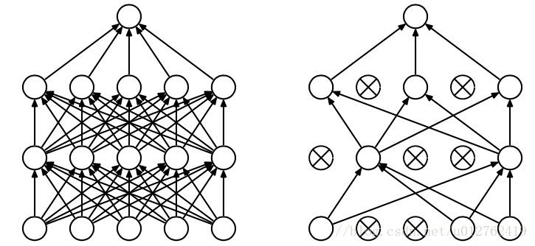
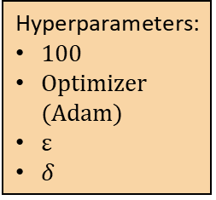
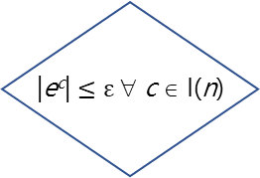

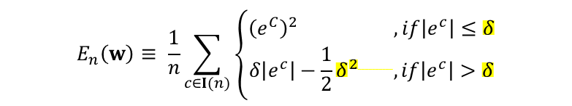
The matching module
helps tune weights to obtain an acceptable net
i = 1
forward
operation
Hyperparameters:
100
Optimizer (Adam)
ε
$δ$
i++
False
i ≥ 100
|e^{c}| $≤\text{ε}$ ∀ c ∈ I(n)
backward operation
False
p is the number of hidden nodes or the probability of dropout?
2n?
m is the number of input nodes or ???
How about n here?
True
True
加入隨機關閉神經元機制(dropout)
B
Unacceptable net
Acceptable net
A
$δ$ = ?
假設我們有n顆神經元(hidden-node)，每顆都可能以p的機率開或不開，因此我們的神經網路的可能總共為2n種
在matching module優先加入dropout機制可大幅降低overfitting
設定最多關閉m個神經元，其中m=n/3(四捨五入)
$$E_{n}\left(w\right)≡ \frac{1}{n}\sum_{c∈I(n)}{\left\{\begin{matrix}{\left(ⅇ^{C}\right)}^{2} , if\left|e^{c}\right|≤δ \\ δ\left|ⅇ^{c}\right|−\frac{1}{2}δ^{2 }, if\left|e^{c}\right|>δ\end{matrix}\right.}$$

Slide 7
debug the code of new algorithm
Cannot validate any learning algorithm through the mathematical proof.
Code the new algorithm first.
How can I do if the code is wrong or if the result of implementing the code is unsatisfied? ← Debug! Debug! And Debug!
First: Debug each block/module through printing out some information associated with the block/module.
Second: Debug the consistency amongst several consecutive blocks through printing out some data flow between these consecutive blocks.
Third: Debug the logic of the whole algorithm through printing out some results.

Slide 8
Fix the algorithm when you find the bug
Debug each block/module through printing out some information regarding it. ← Fix the bugs of each block/module or replace it.
Debug the consistency amongst several consecutive blocks through printing out some information regarding the data flow of these consecutive blocks. ← Fix the inconsistency via fine-tuning some blocks or replacing them.
Debug the logic of the whole algorithm through printing out some results. ← Fix the logic via fine-tuning some blocks or replacing them.
Debugging is a dirty and tedious work!

Slide 9

Developing a new learning algorithm is like playing with Lego – lots of (pre-built or self-built) modules
Where we are now...
不喜歡的pieces/blocks就修改或抽換它

Slide 10
Q&A
Q1: 謝謝教授，我昨天實作時有發現alpha跟beta會越來越靠近，最後就不work了。是否就是因為沒有加上這個The classification inferencing module？
但在流程圖上沒看到這個module，想請問教授這個module是加在cramming module中嗎？
A: If you want, you can add the inferencing module into your algorithm. For instance, the inferencing module can be implemented after the matching module, the cramming module, the regularizing module, and/or the reorganizing module.

Slide 11
Q&A
Q2: 另外在許多module都會用到的SeC，在判斷上只要alpha > beta就為True；但在這個The classification inferencing module我們更進一步要確保alpha > v、beta < -v，這樣理解對嗎？
這樣是否在一開始initializing_module時，我們也要讓初始網路能夠達到alpha > v、beta < -v這樣的條件？
A: Yes, you can add the inferencing module after the initializing module to make sure that alpha = v and beta = -v at the begining.

Slide 12

The initializing module
Step 1: Use the random method to set up an acceptable SLFN with one hidden node through the first two training data {(x¹, y¹), (x², y²)}.（ y¹*y²= -1）
Step 2: Set n = 3.
The stopping criterion
If n > N, STOP.
The ${PO}_{n}^{N}$ module
At the n^{th} stage:
Pick up the first n training data {(x^{c}, y^{c}): c = 1, 2, …, n} and I(n) = {1, 2, …, n}.

Slide 13
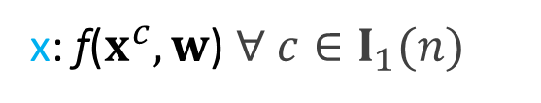



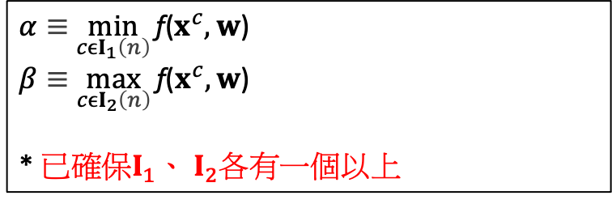
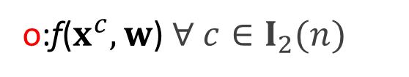
The learning goal of the n^{th} stage : SeC
$y_{}^{c}$ = 1 $∀ c∈I_{1}$(n); $y_{}^{c}$ = -1 $∀ c∈I_{2}$(n);$I$(n) ≡ $I_{1}$(n) ∪ $I_{2}$(n)
x: $\text{f}\text{(}x^{c},w\text{)} ∀ c∈I_{1}(n)$
o:$\text{f}\text{(}x^{c},w\text{)} ∀ c∈I_{2}(n)$
$$β$$
$$α$$
$α≡$ $\min_{cϵI_{1}\left(n\right)}{\text{f}\text{(}x^{c},w\text{)}}$
$β≡$ $\max_{cϵI_{2}\left(n\right)}{\text{f}\text{(}x^{c},w\text{)}}$
* 已確保$I_{1}、$ $I_{2}各有一個以上$
o
o
o
o
x
x
x
x
$$\text{f}\text{(}x^{c},w\text{)}$$
You need to work on all of the initializing module, the selecting module, and the training data to make this happened!

Slide 14
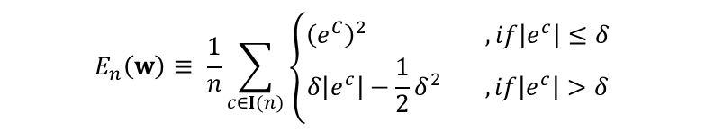
The matching module
helps tune weights to obtain an acceptable net
i = 1
forward
operation
Hyperparameters:
100
Optimizer (Adam)
ε
$δ$
i++
False
i ≥ 100
|e^{c}| $≤\text{ε}$ ∀ c ∈ I(n)
backward operation
False
Yes, you can add the dropout mechanism into the matching module.
You need to check the statements of dropout, for example, Lecture 8-61 ~Lecture 8-72 of CS231n, 2020.
True
True
加入隨機關閉神經元機制(dropout)
B
Unacceptable net
Acceptable net
A
假設我們有n顆神經元(hidden-node)，每顆都可能以p的機率開或不開，因此我們的神經網路的可能總共為2n種
在matching module優先加入dropout機制可大幅降低overfitting
設定最多關閉m個神經元，其中m=n/3(四捨五入)
$$E_{n}\left(w\right)≡ \frac{1}{n}\sum_{c∈I(n)}{\left\{\begin{matrix}{\left(ⅇ^{C}\right)}^{2} , if\left|e^{c}\right|≤δ \\ δ\left|ⅇ^{c}\right|−\frac{1}{2}δ^{2 }, if\left|e^{c}\right|>δ\end{matrix}\right.}$$

Slide 15
Homework #8
Coding your new learning algorithm and debugging it. (can be in a group)
You will show it in the final lecture day, 6/24.

